Slide 1

Rockbuster Relaunch
A strategy presentation for repurposing Rockbuster Stealth for a modern audience.
By Christian Joel Morant

Slide 2

Overview and Goal
Rockbuster Stealth has historically been a video rental service with stores all around the globe. Due to the innovation in streaming services physical video rental services sales have greatly decreased. To solve this issue Rockbuster needs to change and adapt its business strategy.

Slide 3

Key Questions
- What are the average rental rate and duration for video rentals?
- Which movies contributed the most and least revenues?
- In which countries do Rockbuster customers reside?
- Are there any difference in sales between regions?
- Where are the customers who contributed the most lifetime value?

Slide 4





Data Overview
1000 films across 17 genres with over 200 actors
599 Customer from 108 different countries
Rental duration average of 5 days with longest duration being 7 days and shortest duration being 3 days
Rental rate average of $2.98 and an average replacement cost of $19.80

Slide 5
Top 10 Movies
Title
Telegraph Voyage
Zorro Ark
Wife Turn
Innocent Usual
Hustler Party
Saturday Lambs
Titans Jerk
Harry Idaho
Torque Bound
Dogma Family
Revenue
$ 215.75
$ 199.72
$ 198.73
$ 191.74
$ 190.78
$ 190.74 $ 186.73
$ 177.73 $ 169.76
$ 168.72

Slide 6
Bottom 10 Movies
Title
Duffel Apocalypse
Oklahoma Jumanji
Texas Watch
Freedom Cleopatra
Rebel Airport
Young Language
Cruelty Unforgiven
Treatment Jekyll
Lights Deer
Japanese Run
Revenue
$ 5.94
$ 5.94
$ 5.94
$ 5.95
$ 6.93
$ 6.93
$ 6.94
$ 6.94
$ 7.93
$ 7.94

Slide 7
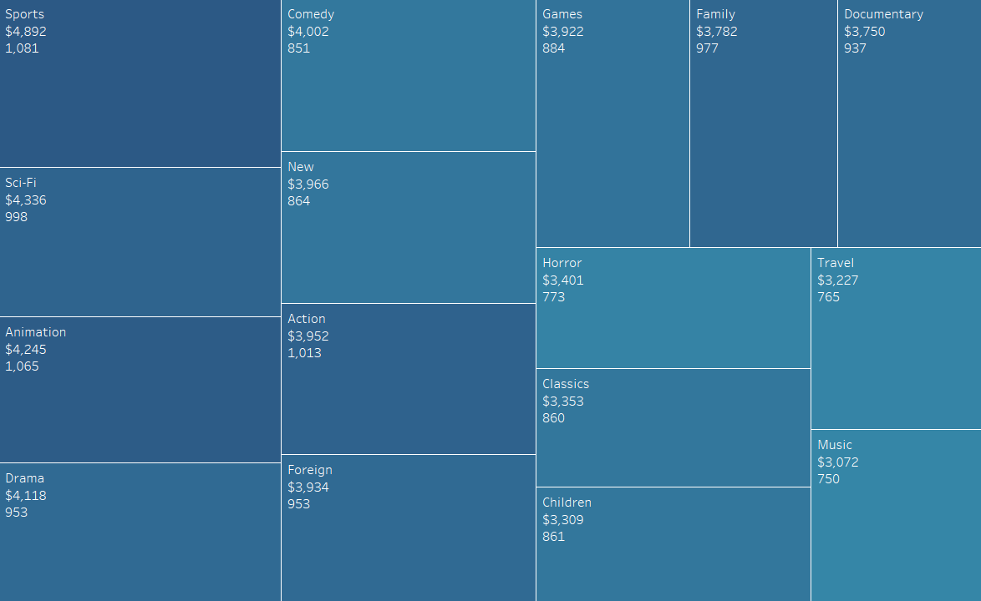
Revenue by Genre
Top 5 Genres
1.) Sports
2.) Sci-Fi
3.) Animation
4.) Drama
5.) Comedy
Bottom 5 Genres
1.) Thriller
2.) Music
3.) Travel
4.) Children
5.) Classics
Revenue
$ 4,892
$ 4,336
$ 4,245
$ 4,118
$ 4,002
$ 0.48
$ 3.07
$ 3.23
$ 3.31
$ 3.35

Slide 8
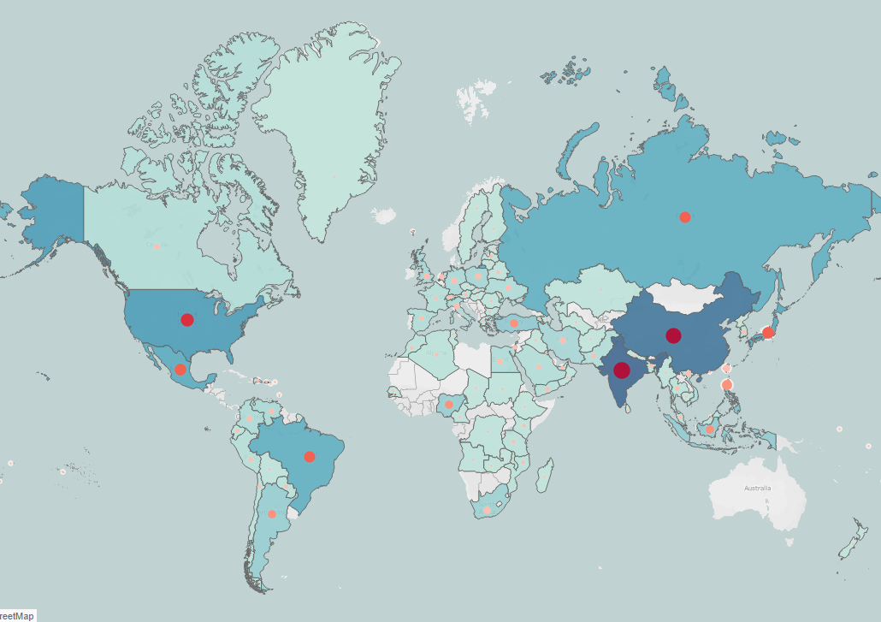
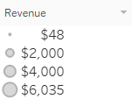
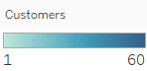
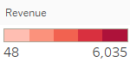
Top 10 Countries by Revenue
Country
India
China
United States
Japan
Mexico
Brazil
Russia
Philippines
Turkey
Indonesia
Customer
60
53
36
31
30
28
28
20
15
14
Revenue
$ 6034.78
$ 5251.03
$ 3685.31
$ 3122.51
$ 2984.82
$ 2919.19
$ 2765.62
$ 2219.7
$ 1498.49
$ 1352.69

Slide 9
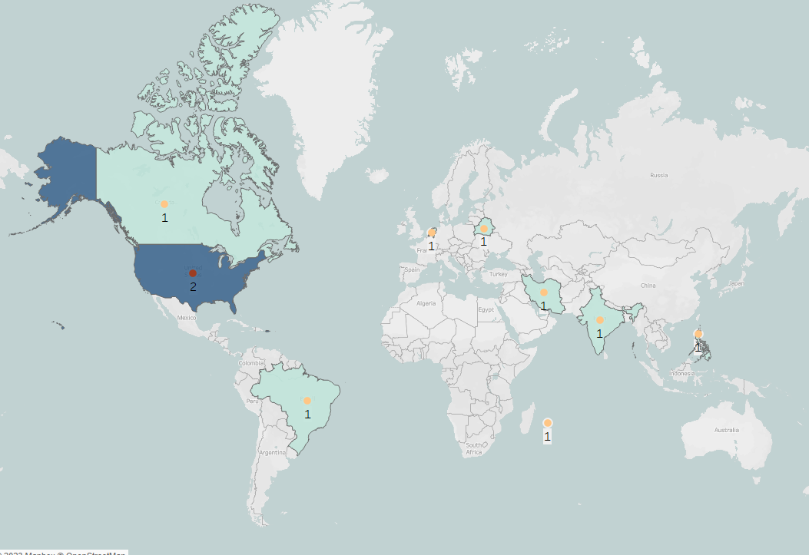
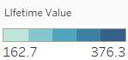
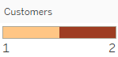
Top 10 Customers by Lifetime Value
Customer
Eleanor Hunt
Karl Seal
Marion Snyder
Rhonda Kennedy
Clara Shaw
Tommy Collazo
Ana Bradley
Curtis Irby
Marcia Dean
Mike Way
Country
Reunion
United States
Brazil
Netherlands
Belarus
Iran
United States
Canada
Philippines
India
Lifetime Value
$ 211.55
$ 208.58
$ 194.61
$ 191.62
$ 189.60
$ 183.63
$ 167.67
$ 167.62
$ 166.61
$ 162.67

Slide 10

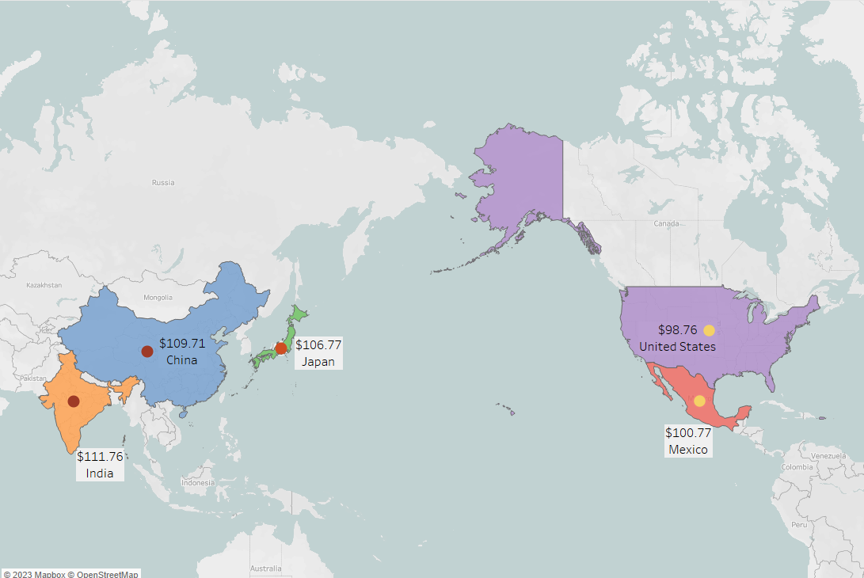
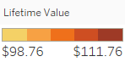
Top 5 Customers by Lifetime Value
Customer
Arlene Harvey
Kyle Spurlock
Marlene Welch
Glen Talbert
Clinton Buford
City/Country
Ambattur - India
Shanwei - China
Iwaki - Japan
Acua - Mexico
Aurora - United States
Lifetime Value
$ 111.76
$ 109.71
$ 106.77
$ 100.77
$ 98.76

Slide 11

Insight and Recommendations
- The films catalog is outdated and requires an update. Rockbuster should focus on acquiring movies from the Top 10 Genres (sports, sci-fi, animation etc).
- Standardize movie rentals to 5-day duration.
- Business should focus on marketing to each different region based on the region's genre and movie preference, with greater focus on the Asia region.
- The business should implement a rewards program that rewards customers for their lifetime value purchases. A trial run can be done for countries with the most customers.

Slide 12

THANK YOU
Any Questions?
Rockbuster Stealth Visuals | Tableau Public

